Slide 1


Important learnings in R
R-shiny, Version Control, Best Practice
Phrances Perez | September 2019

Slide 2

Introduction
Data Analyst at BookingGo (1 year)
Using R for the 6 months
‘Used’ R in university
Main R uses:
Data manipulation
Data visualisation
Dashboarding
Regression
Statistics

Slide 3




What is this talk about?
R shiny and the reactive function
Tips on using version control
Best Practice

Slide 4

R Shiny: reactive function

Slide 5

Reactive function
When a normal expression is wrapped by the reactive function, it becomes dynamic which allows the result to change.
The effect of these dynamic changes is rippled down on the expressions that relies on the reactive ones.

Slide 6
Normal Structure
Input
in ui.R
common use: filters
Output
created in server.R
which can rely on inputs
loaded in the ui

Slide 7
Reactive Structure
Input
in ui.R
common use: filters
reactive
relies on an input
useful for objects that are needed multiple times
Output
created in server.R
which can rely on inputs
loaded in the ui

Slide 8
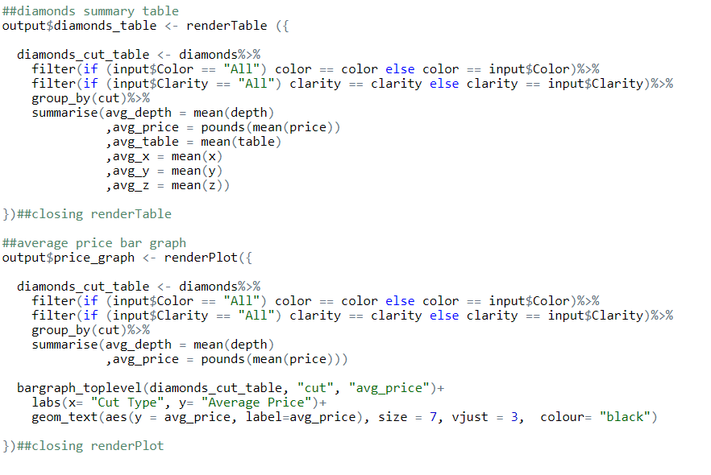
Demo: Normal structure
RenderTable to create a table output
Imagine plotting more graphs using this table! Your code would be so long!
Reuse that table to plot a graph using renderPlot
Notes:
21 lines of code

Slide 9
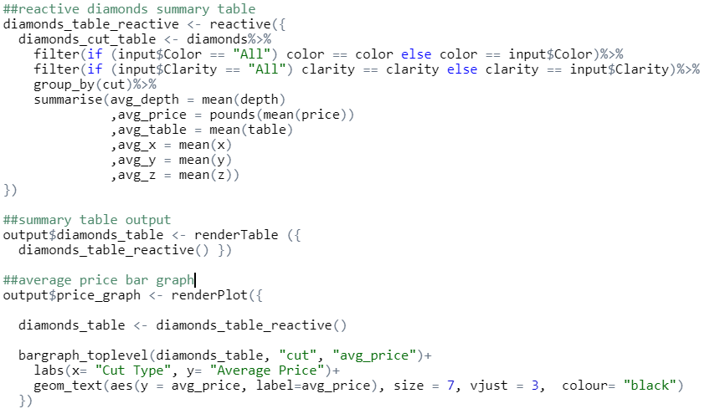
Demo: Reactive structure
Functionise table using reactive function
You can ‘call’ the table multiple times and use it
Notes:
18 lines of code

Slide 10

Advantages of using reactive function
create expressions that rely on other expressions
reusable expressions
shorter codes
Rshiny bug - cannot load the same output twice

Slide 11
Git and version control

Slide 12
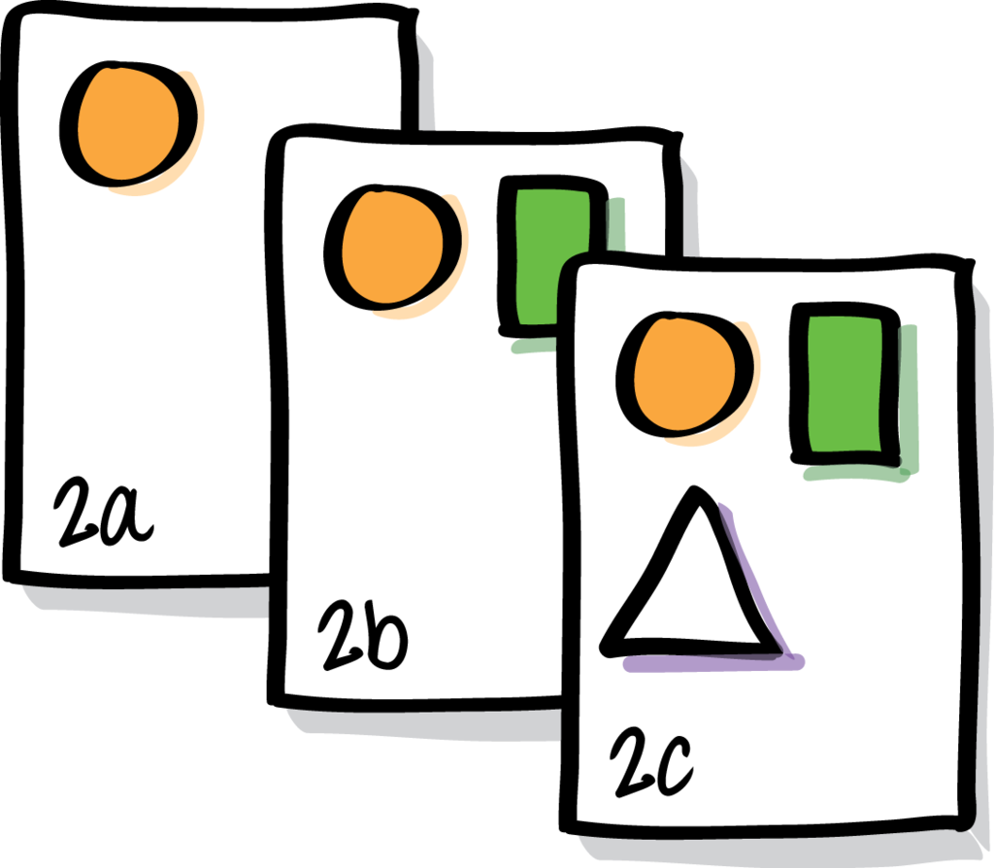
Version Control
Management of changes made in the source code and mainly used to retain copies of the different versions of the code with the appropriate label/comment.

Slide 13
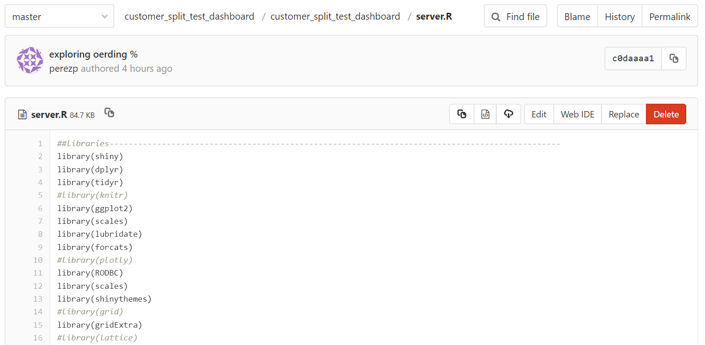
History
Git interface
Copy Path
Edit
Code

Slide 14
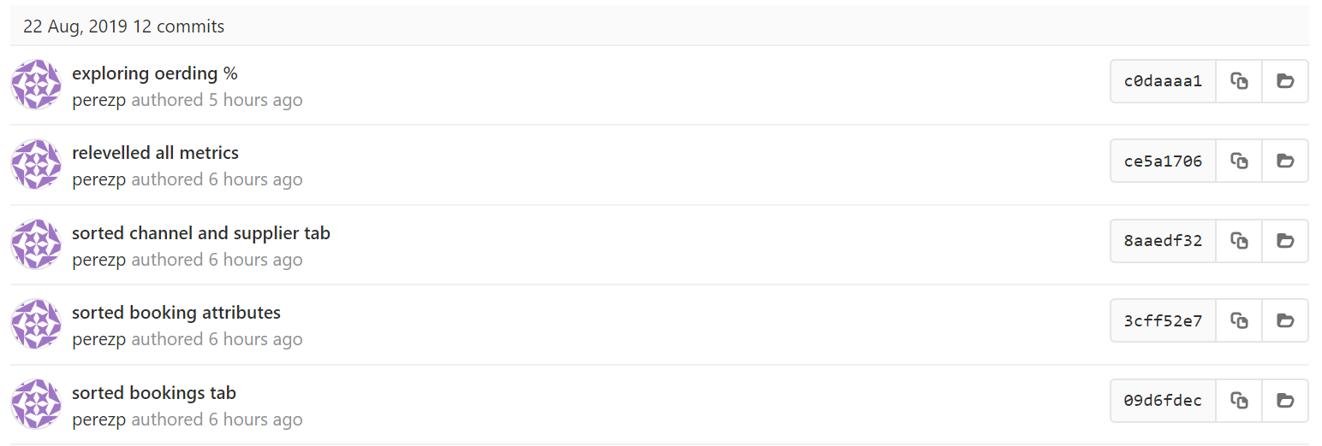
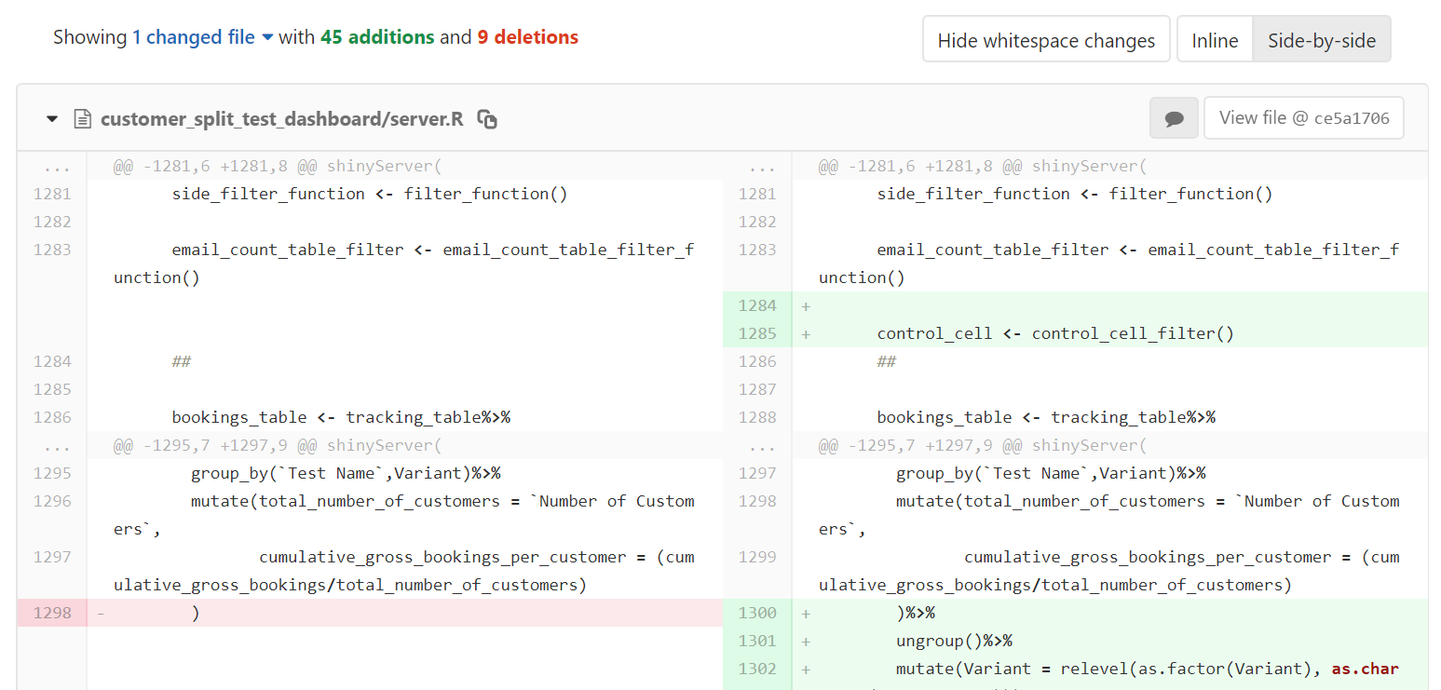
Git interface
You can see any changes you’ve made
History log of your commits/comments

Slide 15


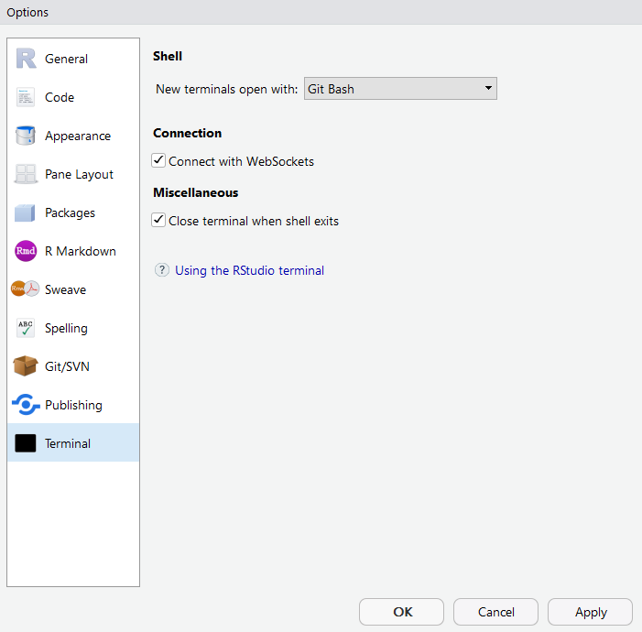
How to use Git in R?
1. Install the GIT bash app
(esp . for windows)
2. Tools > Global options > Terminal > ‘New terminals open with : GIT Bash’

Slide 16
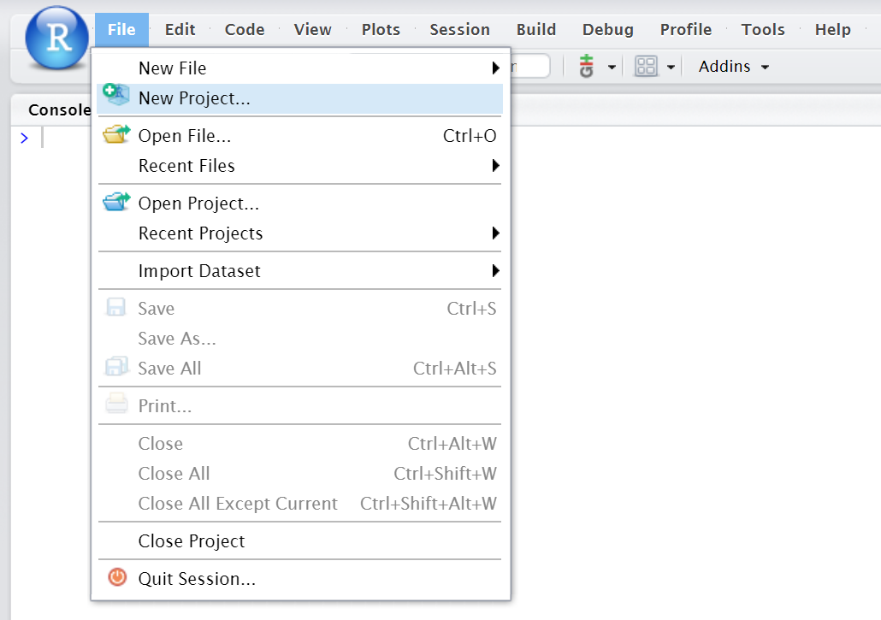
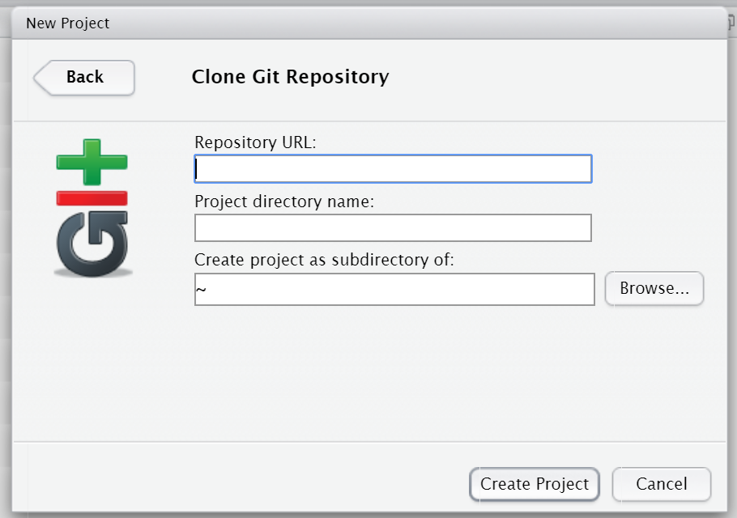
How to use Git in R?
3. File > New Project
4. Click Version Control > Git

Slide 17
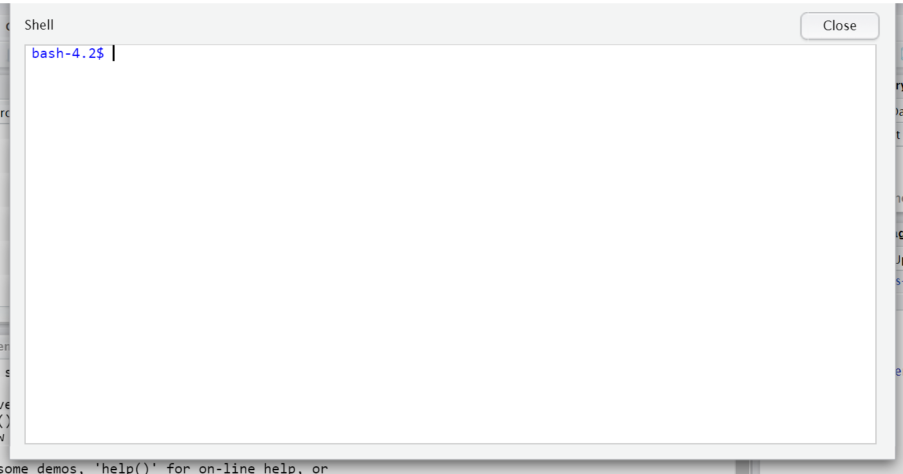
How to use Git in R?
5. Paste SSH URL to Repository URL > Create Project
**This step will clone the repository and you can now use version control
6. Add some file and let’s submit it to git :)
7. Go to Tools > Shell
8. Use git commands to ‘push’ changes

Slide 18
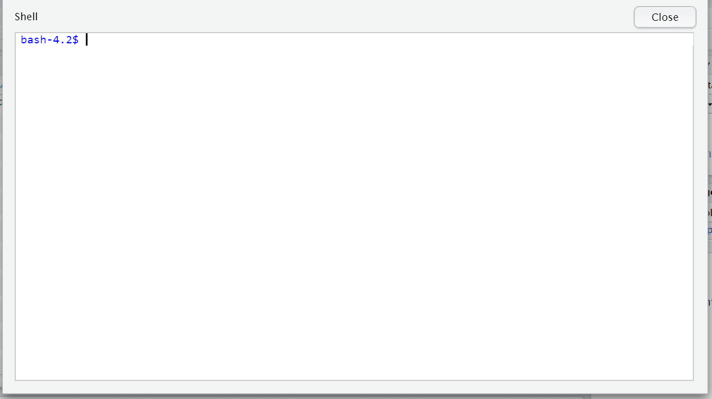
Git commands
pwd : to check your working directory
if it shows the wrong directory use cd <whatever directory you want to check> to redirect it
git pull : this is to make sure that your repository is up to date(repository is where your project is stored).
git status: to check what you have done (will shows the files you have added, modified or deleted)
git add <file name>: to add the file to git (use ‘git add .’ to add everything)
git commit -m ‘’: add a comment inside the quotations(make sure your comment is intuitive)
git push: final stage to send it to git

Slide 19

Advantages of version control
Stores changes - automatic back up
Going back to working version
Easily view different versions
Views on differences between versions
Helps understand what happened
Collaboration - share on multiple users (branching)

Slide 20
Tips on version control
When to version control?
Keeping a working version is always a good start
Drastic changes
Small changes
At the end of your session
As much as possible!
What comments?
Explain briefly what you’ve done (imagine trying to find those changes in your history)
‘Working version’
‘Small edits’ is ok
‘Functionised summary table’

Slide 21
Best Practice

Slide 22
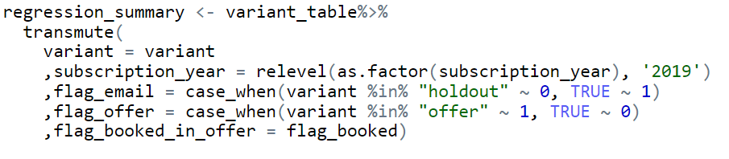
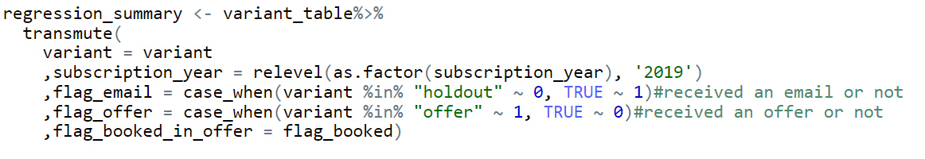
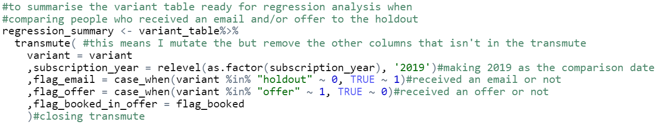
Comments
No clue what’s going on at first glance
Will have to read the code vigorously to understand
Some idea of what’s going on
Doesn’t really explain what the writer was trying to do
Intuitive
Easy to read
Easy to understand what’s going on

Slide 23
Tips on Commenting
Explain any ‘unusual’ functions and why you’re using them.
Answer the question ‘Why?’ (ie. Why are you creating this table?
Identify closing brackets.
Just imagine reading your code in a few months time!
What are you trying to do?

Slide 24
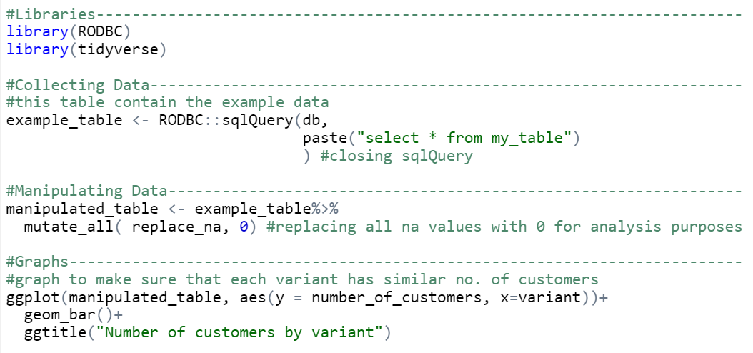
Code Structure
Section your code (#comment--------------- or #comment####)
Spacing helps too!
A line of code doesn’t have to be on the same line
Try and follow a logical approach
Use comments

Slide 25
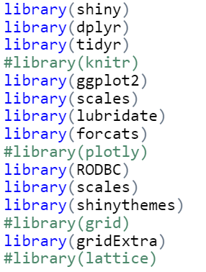
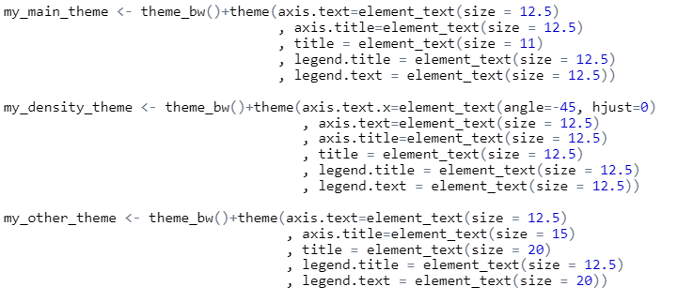
Save your go to codes!
Save your main libraries
Comment out/remove the ones you aren’t using
These are themes that I reuse a lot
Saves time because I don’t have to rewrite them

Slide 26
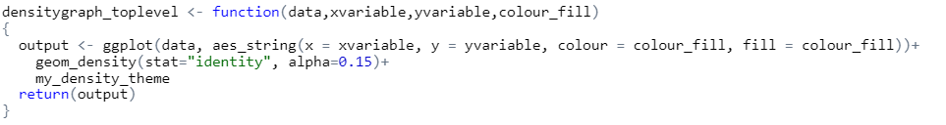
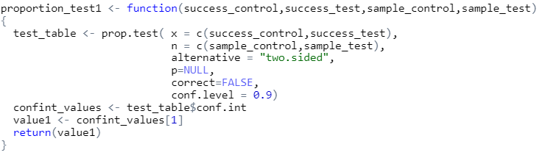
Functions
Functionise anything that you are repeatedly using to make your code shorter and easier to understand.
Functionalized types of graphs that are repeatedly used
Function that collects the first confidence interval
Created the same for the 2nd value

Slide 27
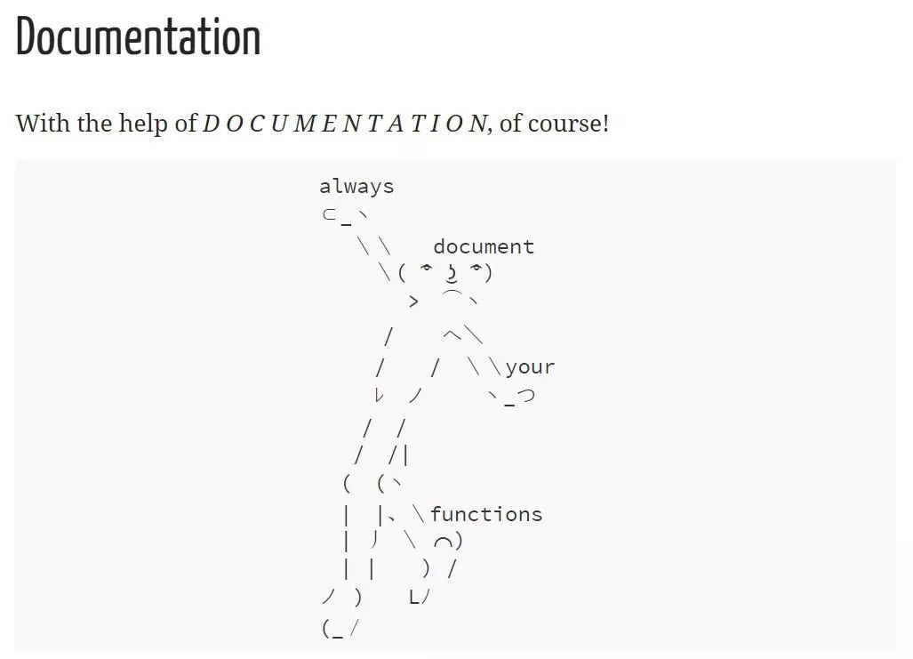
Link: https://github.com/phrances-paps/RLadies_presentation

Slide 28

Any questions? :)

Slide 29
Appendix

Slide 30
Git and version control

Slide 31
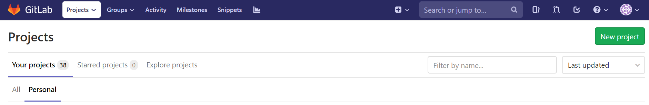
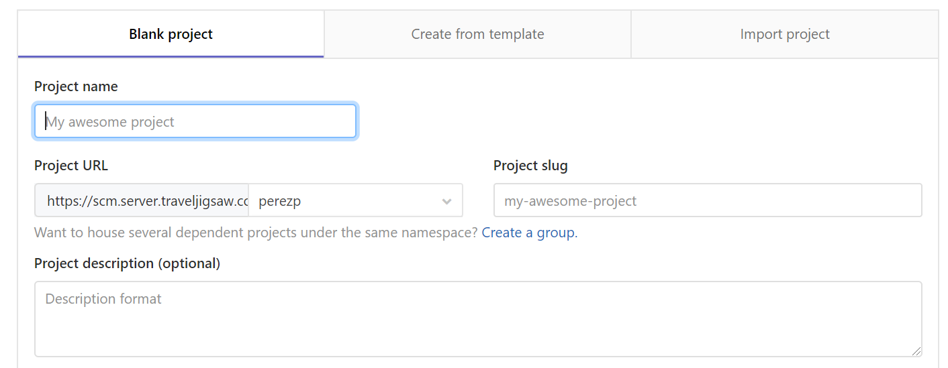
How get your SSH url?
Go to your GitLab.
2. Click on ‘New Project’

Slide 32
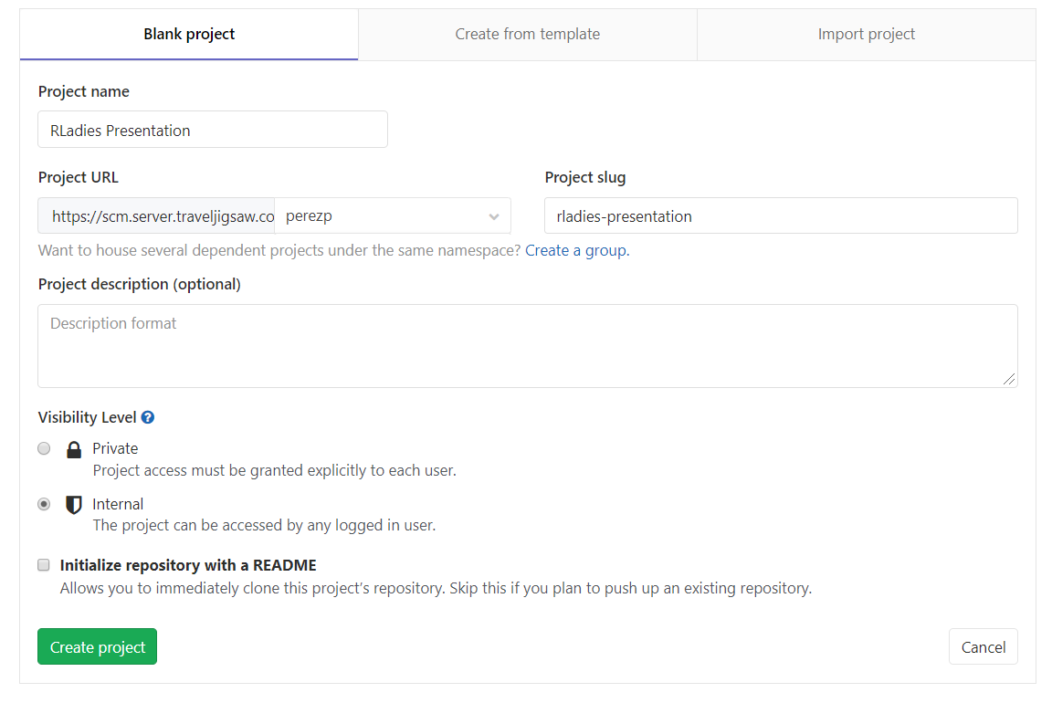
How get your SSH url?
3. Fill the information
Note: Make sure to name your project something intuitive.
4. Click on ‘Create Project’

Slide 33
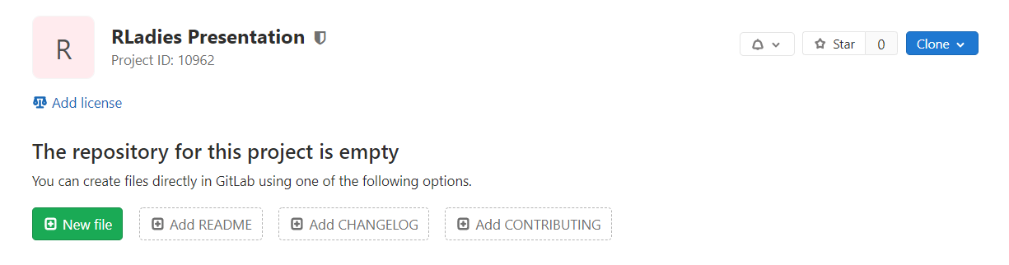
How get your SSH url?
5. Clone your repository.

Slide 34
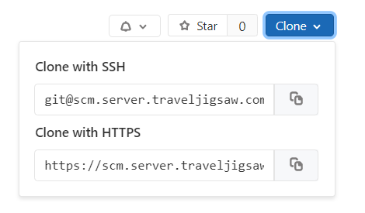
How get your SSH url?
6. Copy your SSH url.
7. Go to RStudio.

